Slide 1

Magnetic Drug Targeting
This model was provided by Daniel J. Strauss, The Institute for New Materials, Inc., www.inm-gmbh.de

Slide 2
Introduction
Magnetic liquids such as ferrofluids can play an important role as drug carriers in the human body. As such, they can be used for drug targeting in modern locoregional cancer treatment.
To avoid damage on healthy human cells made by chemotherapy drugs, one always faces an upper limit in the treatment dose. This limit impedes the chances of successful treatment of the tumor cells. Drug targeting can concentrate chemotherapy drugs locally to tumor tissue, and to weaken the global exposure to the organism.

Slide 3
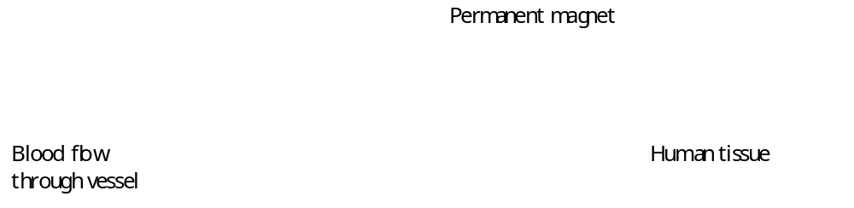
Problem Definition – Geometry
This model example demonstrates a simple setup to investigate an external magnetic field and its interaction with blood flow with a magnetic carrier substance. As a first approximation the model is done in 2D.

Slide 4




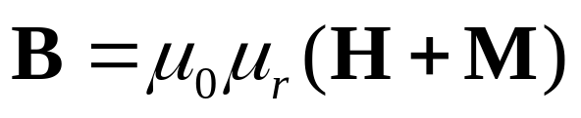
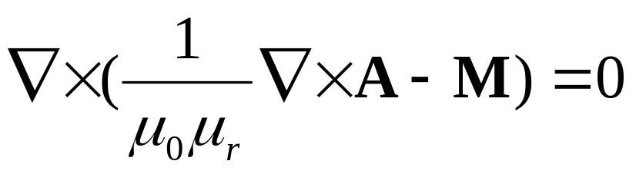
Problem Definition –
Domain Equations, Magnetostatics
Maxwells law for the magnetic field and current (static)
Gauss’ theorem for the magnetic flux density (B-field)
Definition of a magnetic vector potential A
Constitutive relation to tie B-H (M is magnetization)
Combining the above equations
gives, for zero currents

Slide 5
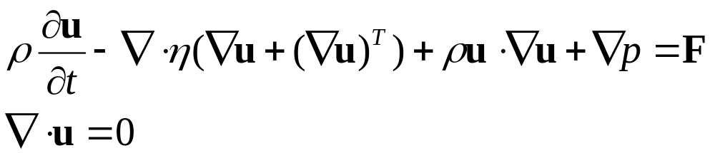
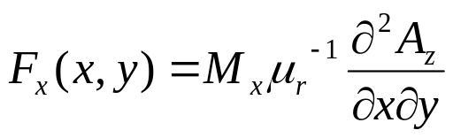
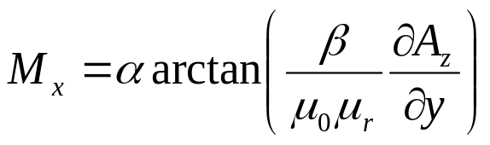
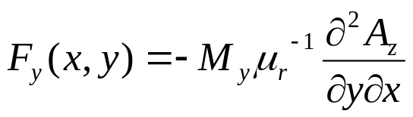
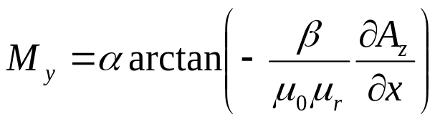
Problem Definition –
Domain Equations, Fluid dynamics
Incompressible Navier Stoke’s equations
The F term is a volume force (F_{x}, F_{y}) that in this case is constituted by a magnetic force
Where M is the induced magnetization of the magnetic fluid

Slide 6


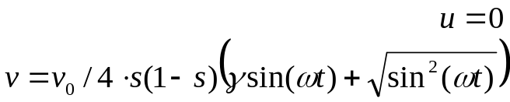

Problem Definition – Boundary Conditions
Magnetostatics
  Reasonably far away from the magnet, magnetic insulation is applied: A_{z}=0
Navier Stokes
  A pulsating inlet velocity simulates the heart beat.
  No-slip on walls
  Pressure on outlet
A_{z}=0

Slide 7
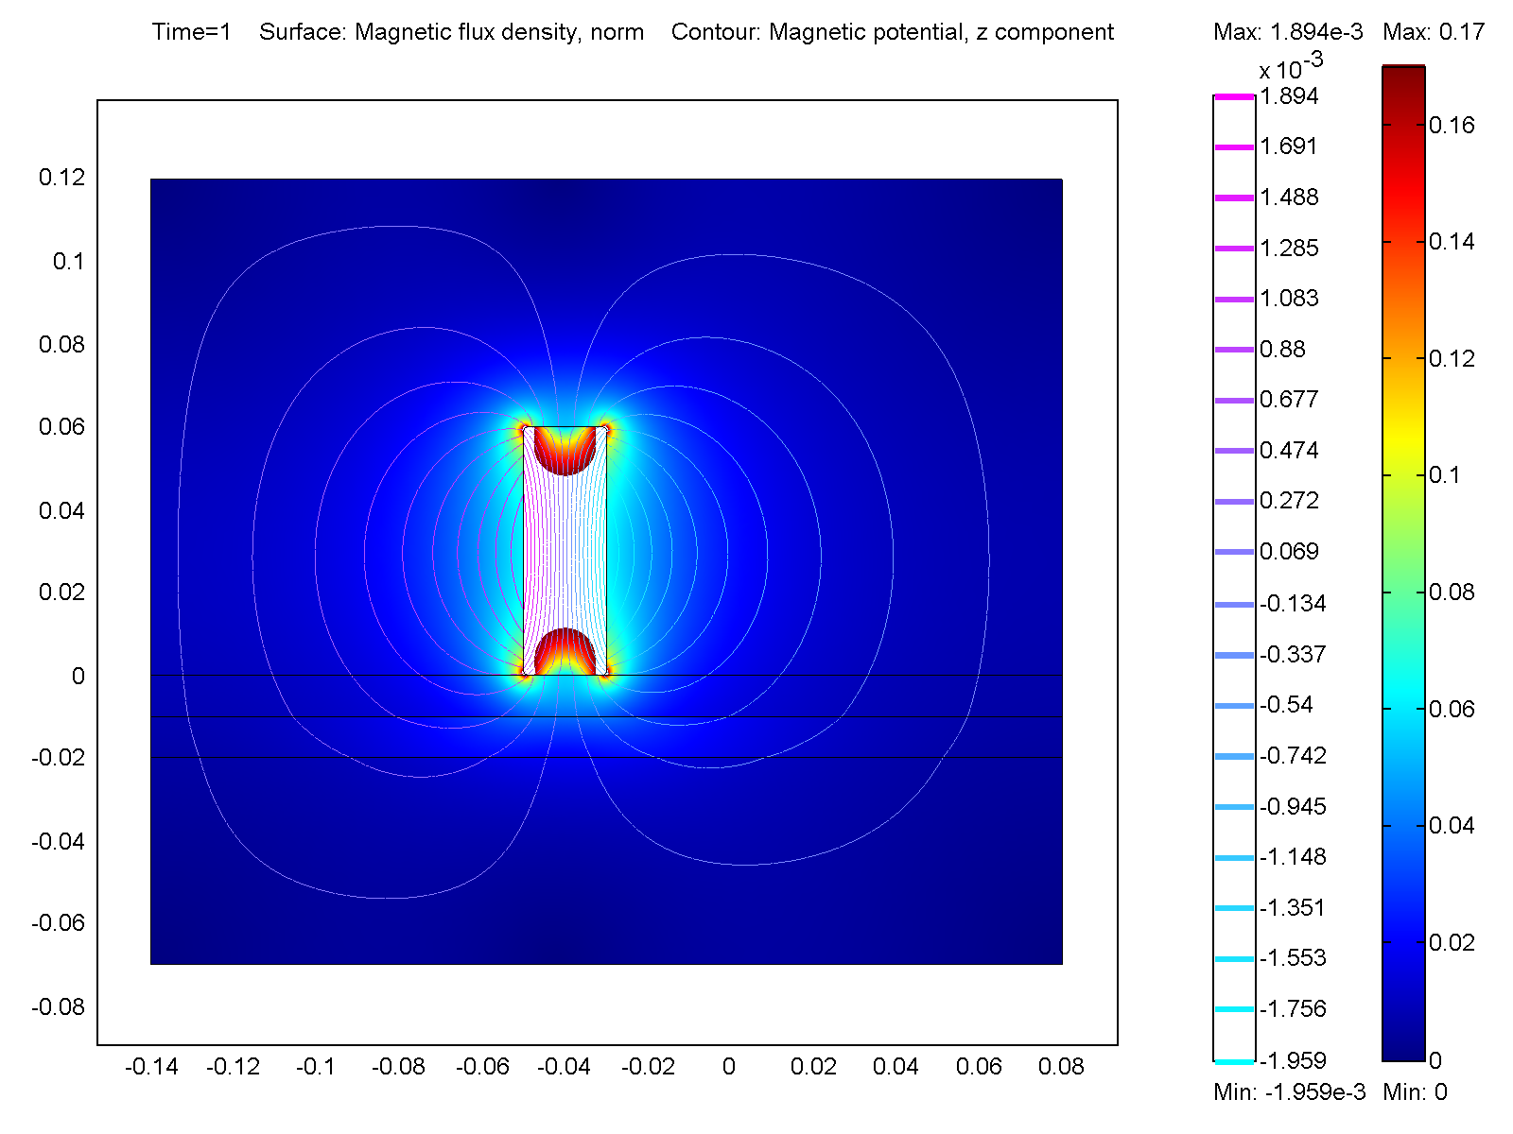
Results – magnetic field
The magnetic flux density has a maximum near the sharp corners. White areas are excluced from the plot range for clarity.
The interesting area is the blood vessel.

Slide 8
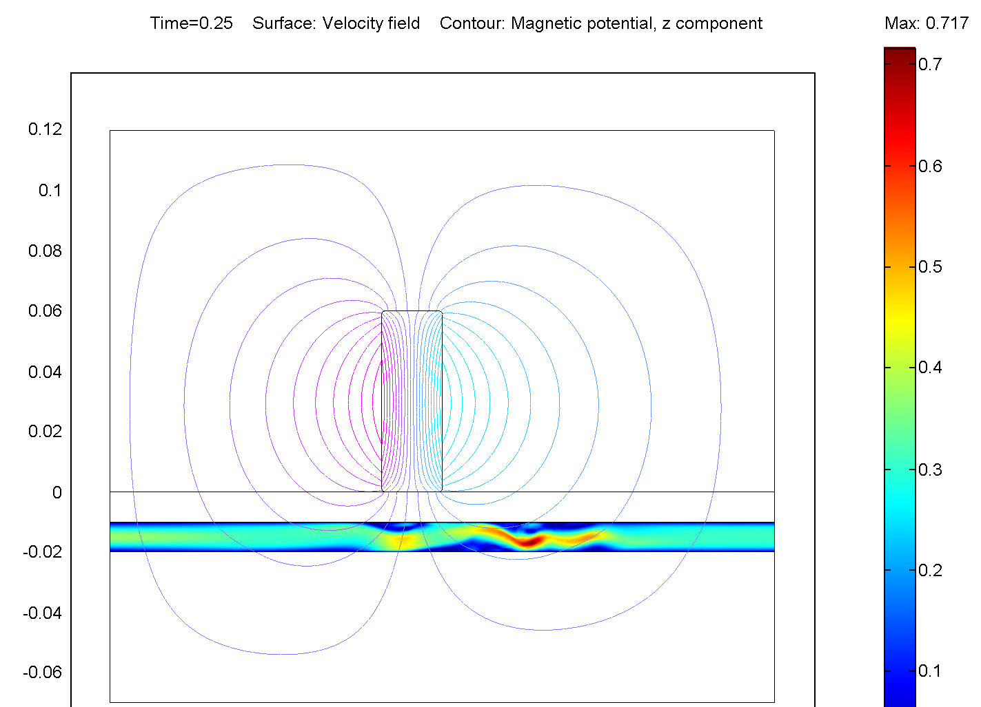
Results – Velocity Field at max blood throughput (heat beat), t=0.25.
The flow field is clearly distorted by the magnet

Slide 9
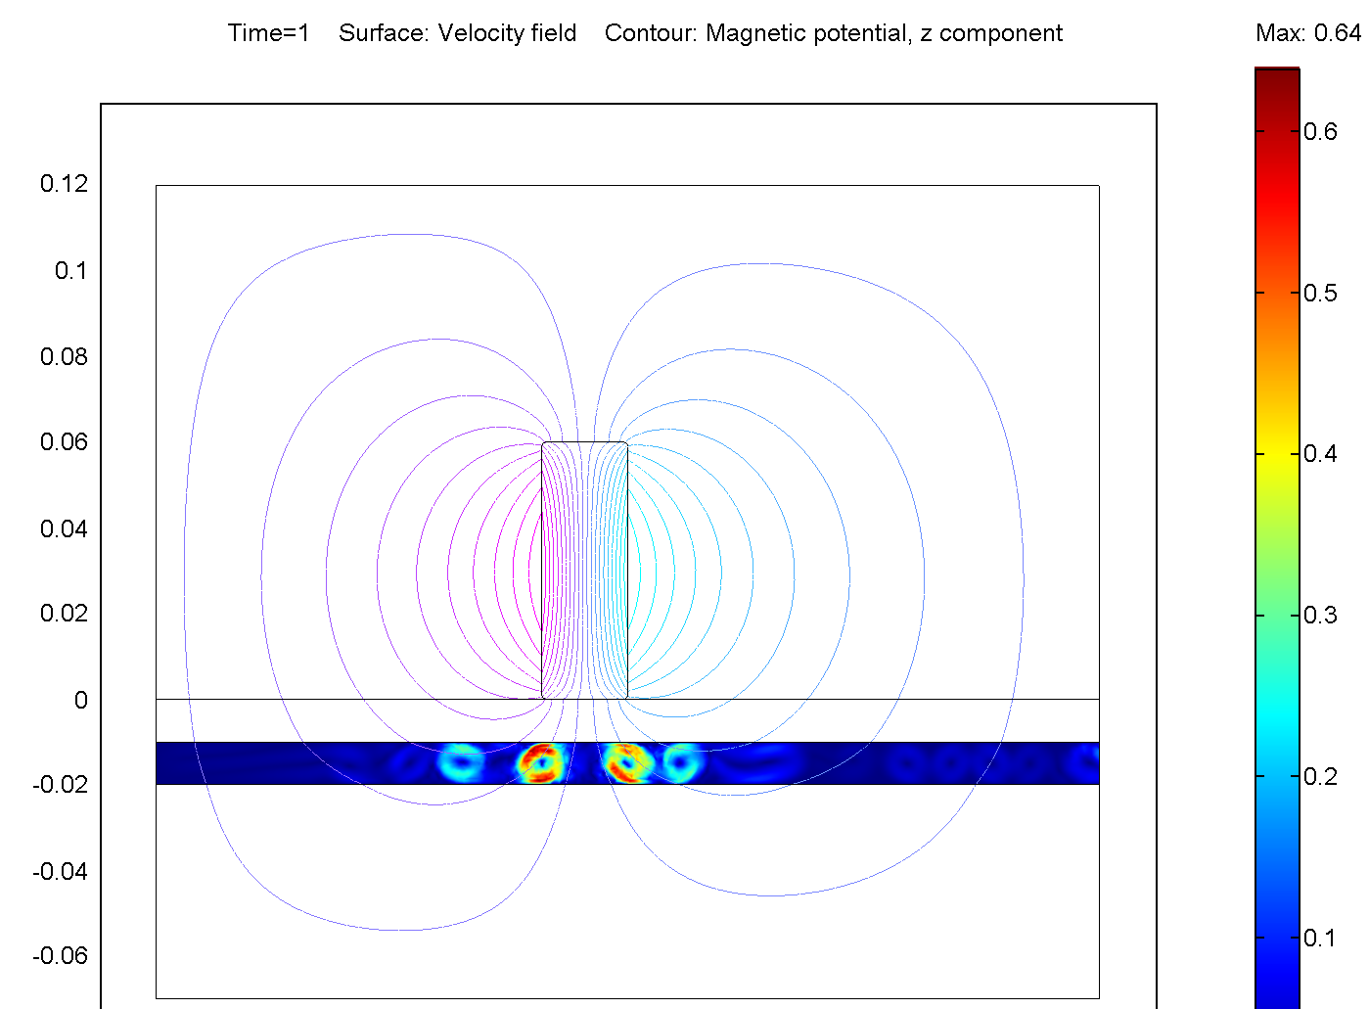
Results – Velocity Field at zero throughput, t=1
Even though the net flow is zero, we can see agitation in eddies generated by the magnetic field.

Slide 10
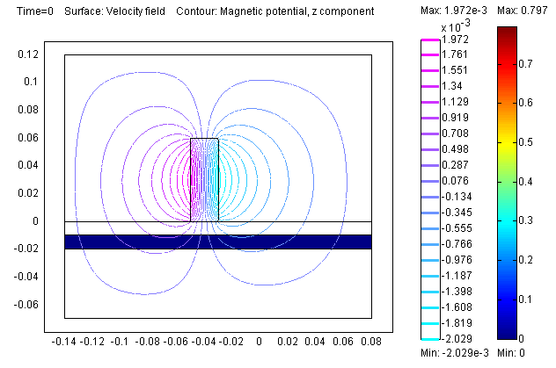
Results – movie

Slide 11
Results - Conclusions
Certain points near the magnetic disturbances will be exposed to a larger flow rate per unit area, (close to the reddish areas) whereas some parts will get less exposed (blue areas near vessel wall).
COMSOL Multiphysics is a good tool to test different flowrates and geometries to get guidance how to set up magnetic targeting equipment.

